Slide 1
OO Programming Concepts
Object-oriented programming (OOP) involves programming using objects. An object represents an entity in the real world that can be distinctly identified. For example, a student, a desk, a circle, a button, and even a loan can all be viewed as objects. An object has a unique identity, state, and behaviors. The state of an object consists of a set of data fields (also known as properties) with their current values. The behavior of an object is defined by a set of methods.

Slide 2

Objects
An object has both a state and behavior. The state defines the object, and the behavior defines what the object does.

Slide 3
Classes
Classes are constructs that define objects of the same type. A Java class uses variables to define data fields and methods to define behaviors. Additionally, a class provides a special type of methods, known as constructors, which are invoked to construct objects from the class.

Slide 4
Java naming convention is a rule to follow as you decide what to name your identifiers such as class, package, variable, constant, method etc.
But, it is not forced to follow. So, it is known as convention not rule.
All the classes, interfaces, packages, methods and fields of java programming language are given according to java naming convention.
Notes:
https://www.javatpoint.com/java-naming-conventions

Slide 5
Name | Convention
class name | should start with uppercase letter and be a noun e.g. String, Color, Button, System, Thread etc.
interface name | should start with uppercase letter and be an adjective e.g. Runnable, Remote, ActionListener etc.
method name | should start with lowercase letter and be a verb e.g. actionPerformed(), main(), print(), println() etc.
variable name | should start with lowercase letter e.g. firstName, orderNumber etc.
package name | should be in lowercase letter e.g. java, lang, sql, util etc.
constants name | should be in uppercase letter. e.g. RED, YELLOW, MAX_PRIORITY etc.

Slide 6
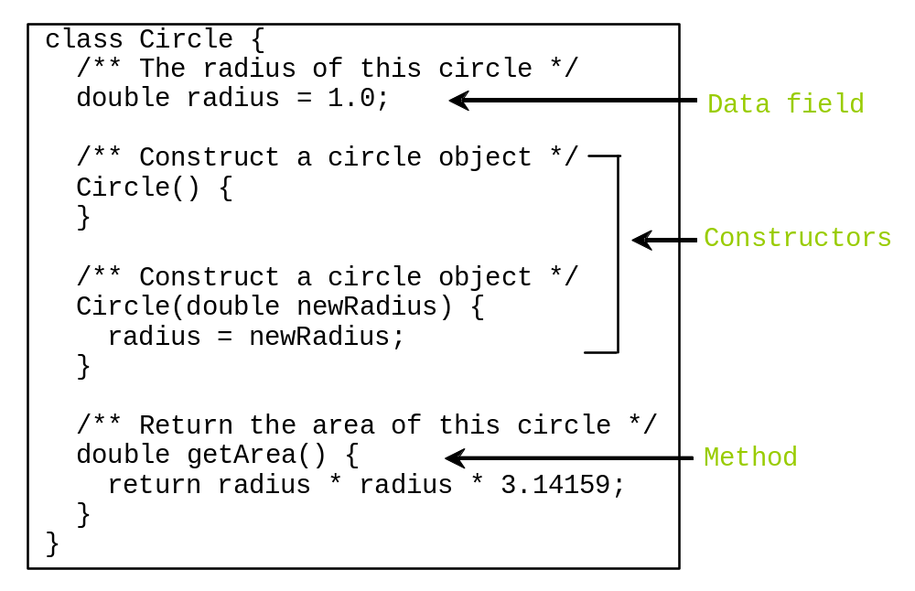
Classes

Slide 7
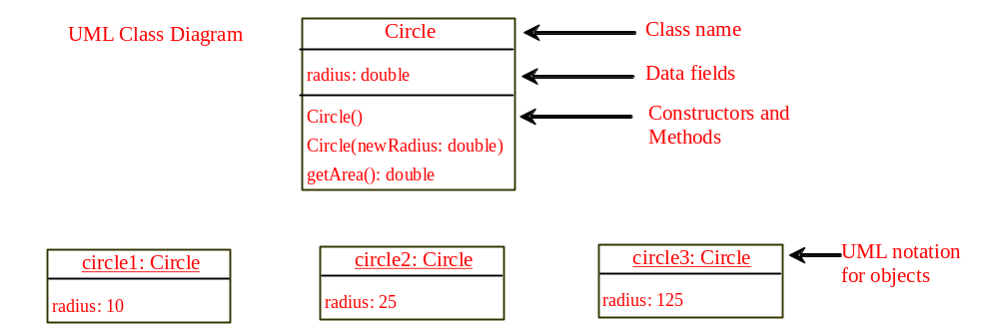
UML Class Diagram

Slide 8
Constructors
Constructors are a special kind of methods that are invoked to construct objects.
Circle() {
}
Circle(double newRadius) {
radius = newRadius;
}

Slide 9
Constructors, cont.
A constructor with no parameters is referred to as a no-arg constructor.
· Constructors must have the same name as the class itself.
· Constructors do not have a return type—not even void.
· Constructors are invoked using the new operator when an object is created. Constructors play the role of initializing objects.

Slide 10
Creating Objects Using Constructors
new ClassName();
Example:
new Circle();
new Circle(5.0);

Slide 11
Default Constructor
A class may be declared without constructors. In this case, a no-arg constructor with an empty body is implicitly declared in the class. This constructor, called a default constructor, is provided automatically only if no constructors are explicitly declared in the class.

Slide 12
Declaring Object Reference Variables
To reference an object, assign the object to a reference variable.
To declare a reference variable, use the syntax:
ClassName objectRefVar;
Example:
Circle myCircle;

Slide 13
Declaring/Creating Objects in a Single Step
ClassName objectRefVar = new ClassName();
Example:
Circle myCircle = new Circle();
Assign object reference
Create an object

Slide 14
Accessing Objects
Referencing the object’s data:
objectRefVar.data
e.g., myCircle.radius
Invoking the object’s method:
objectRefVar.methodName(arguments)
e.g., myCircle.getArea()

Slide 15
A Simple Circle Class
Objective: Demonstrate creating objects, accessing data, and using methods.
TestCircle1
Run

Slide 16
Trace Code
animation
Declare myCircle
Circle myCircle = new Circle(5.0);
SCircle yourCircle = new Circle();
yourCircle.radius = 100;
myCircle
no value
Notes:
Check again Check again Check again Check again

Slide 17

Trace Code, cont.
animation
Circle myCircle = new Circle(5.0);
Circle yourCircle = new Circle();
yourCircle.radius = 100;
myCircle
no value
Create a circle

Slide 18
Trace Code, cont.
animation
Circle myCircle = new Circle(5.0);
Circle yourCircle = new Circle();
yourCircle.radius = 100;
myCircle
reference value
Assign object reference to myCircle

Slide 19
Trace Code, cont.
animation
Circle myCircle = new Circle(5.0);
Circle yourCircle = new Circle();
yourCircle.radius = 100;
myCircle
reference value
yourCircle
no value
Declare yourCircle

Slide 20

Trace Code, cont.
animation
Circle myCircle = new Circle(5.0);
Circle yourCircle = new Circle();
yourCircle.radius = 100;
myCircle
reference value
yourCircle
no value
Create a new Circle object

Slide 21

Trace Code, cont.
animation
Circle myCircle = new Circle(5.0);
Circle yourCircle = new Circle();
yourCircle.radius = 100;
myCircle
reference value
yourCircle
reference value
Assign object reference to yourCircle

Slide 22

Trace Code, cont.
animation
Circle myCircle = new Circle(5.0);
Circle yourCircle = new Circle();
yourCircle.radius = 100;
myCircle
reference value
yourCircle
reference value
Change radius in yourCircle

Slide 23
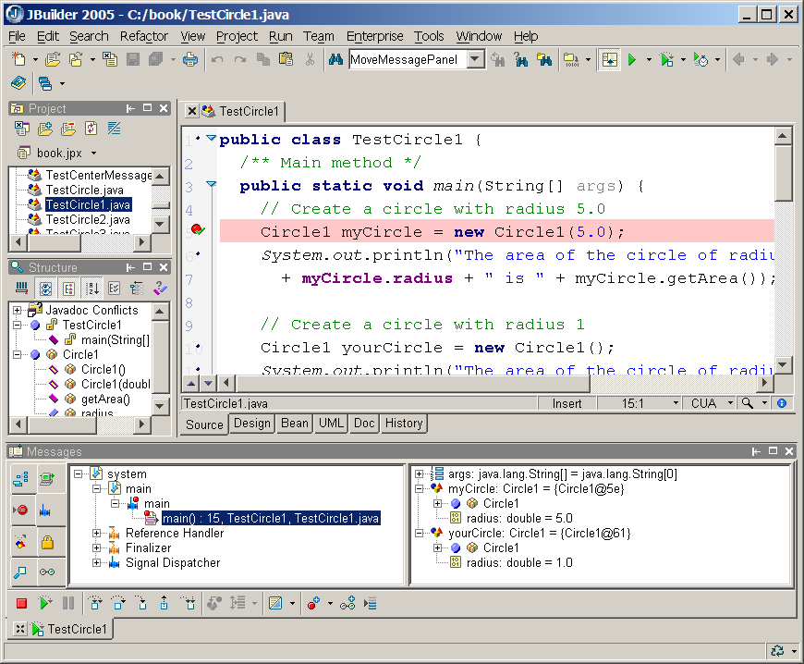
See Objects in JBuilder Debugger
JBuilder Optional
You can view the contents of an object in the debugger.
myCircle
yourCircle

Slide 24
Caution
Recall that you use
  Math.methodName(arguments) (e.g., Math.pow(3, 2.5))
to invoke a method in the Math class. Can you invoke getArea() using Circle1.getArea()? The answer is no. All the methods used before this chapter are static methods, which are defined using the static keyword. However, getArea() is non-static. It must be invoked from an object using
  objectRefVar.methodName(arguments) (e.g., myCircle.getArea()).
More explanations will be given in Section 7.7, “Static Variables, Constants, and Methods.”

Slide 25
Reference Data Fields
The data fields can be of reference types. For example, the following Student class contains a data field name of the String type.
public class Student {
String name; // name has default value null
int age; // age has default value 0
boolean isScienceMajor; // isScienceMajor has default value false
char gender; // c has default value '\u0000'
}

Slide 26
The null Value
If a data field of a reference type does not reference any object, the data field holds a special literal value, null.

Slide 27
Default Value for a Data Field
The default value of a data field is null for a reference type, 0 for a numeric type, false for a boolean type, and '\u0000' for a char type. However, Java assigns no default value to a local variable inside a method.
public class Test {
public static void main(String[] args) {
Student student = new Student();
System.out.println("name? " + student.name);
System.out.println("age? " + student.age);
System.out.println("isScienceMajor? " + student.isScienceMajor);
System.out.println("gender? " + student.gender);
}
}

Slide 28
Example
Java assigns no default value to a local variable inside a method.
public class Test {
public static void main(String[] args) {
int x; // x has no default value
String y; // y has no default value
System.out.println("x is " + x);
System.out.println("y is " + y);
}
}
Compilation error: variables not initialized

Slide 29

Differences between Variables of
Primitive Data Types and Object Types

Slide 30

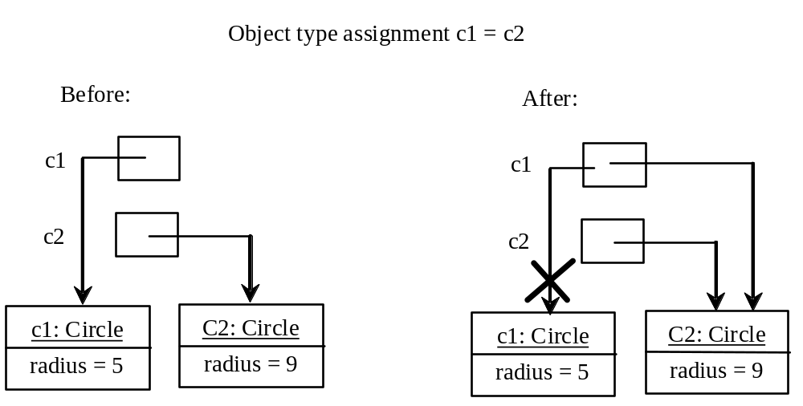
Copying Variables of Primitive Data Types and Object Types

Slide 31
Garbage Collection
As shown in the previous figure, after the assignment statement c1 = c2, c1 points to the same object referenced by c2. The object previously referenced by c1 is no longer referenced. This object is known as garbage. Garbage is automatically collected by JVM.

Slide 32
Garbage Collection, cont
TIP: If you know that an object is no longer needed, you can explicitly assign null to a reference variable for the object. The JVM will automatically collect the space if the object is not referenced by any variable.

Slide 33
Using Classes from the Java Library
Example 7.1 declared the Circle1 class and created objects from the class. Often you will use the classes in the Java library to develop programs. You learned to obtain the current time using System.currentTimeMillis() in Example 2.5, “Displaying Current Time.” You used the division and remainder operators to extract current second, minute, and hour.

Slide 34

The Date Class
Java provides a system-independent encapsulation of date and time in the java.util.Date class. You can use the Date class to create an instance for the current date and time and use its toString method to return the date and time as a string.

Slide 35
The Date Class Example
For example, the following code
  java.util.Date date = new java.util.Date();
  System.out.println(date.toString());
displays a string like Sun Mar 09 13:50:19 EST 2003.

Slide 36

The Random Class
You have used Math.random() to obtain a random double value between 0.0 and 1.0 (excluding 1.0). A more useful random number generator is provided in the java.util.Random class.

Slide 37
The Random Class Example
If two Random objects have the same seed, they will generate identical sequences of numbers. For example, the following code creates two Random objects with the same seed 3.
Random random1 = new Random(3);
System.out.print("From random1: ");
for (int i = 0; i < 10; i++)
System.out.print(random1.nextInt(1000) + " ");
Random random2 = new Random(3);
System.out.print("\nFrom random2: ");
for (int i = 0; i < 10; i++)
System.out.print(random2.nextInt(1000) + " ");
From random1: 734 660 210 581 128 202 549 564 459 961
From random2: 734 660 210 581 128 202 549 564 459 961

Slide 38
Instance
Variables, and Methods
Instance variables belong to a specific instance.
Instance methods are invoked by an instance of the class.

Slide 39
Static Variables, Constants, and Methods
Static variables are shared by all the instances of the class.
Static methods are not tied to a specific object.
Static constants are final variables shared by all the instances of the class.

Slide 40
Static Variables, Constants, and Methods, cont.
To declare static variables, constants, and methods, use the static modifier.

Slide 41
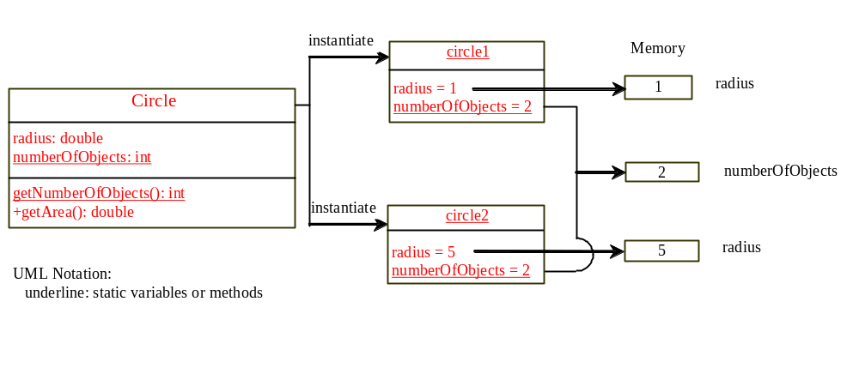
Static Variables, Constants, and Methods, cont.

Slide 42
Example of
Using Instance and Class Variables and Method
Objective: Demonstrate the roles of instance and class variables and their uses. This example adds a class variable numberOfObjects to track the number of Circle objects created.
Circle2
TestCircle2
Run

Slide 43
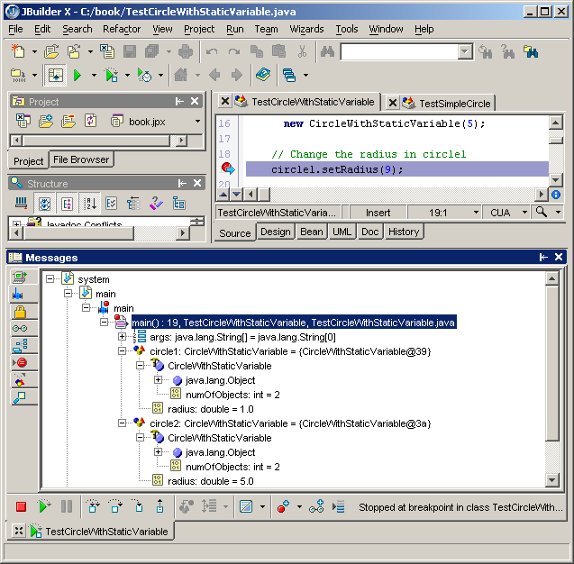
See Objects in JBuilder Debugger
Optional for JBuilder
You can view the contents of an object in the debugger.
Static variable numberOfObjects

Slide 44
Visibility Modifiers and
Accessor/Mutator Methods
By default, the class, variable, or method can be
accessed by any class in the same package.
public
The class, data, or method is visible to any class in any package.
private
The data or methods can be accessed only by the declaring class.
The get and set methods are used to read and modify private properties.

Slide 45
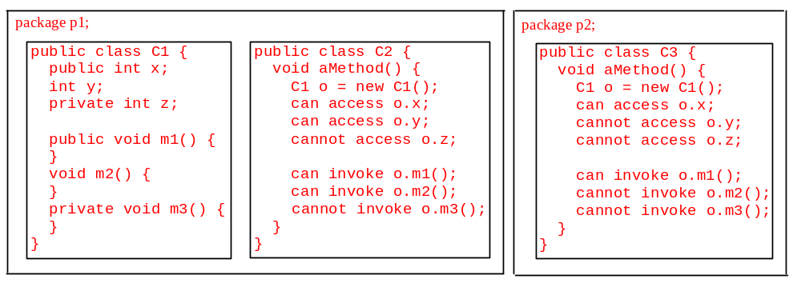
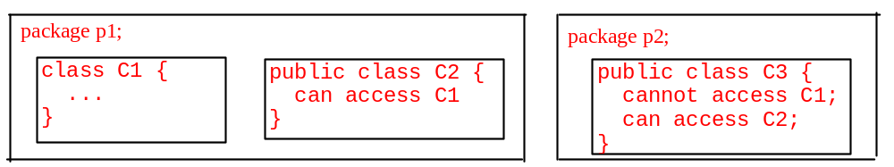
The private modifier restricts access to within a class, the default modifier restricts access to within a package, and the public modifier enables unrestricted access.

Slide 46
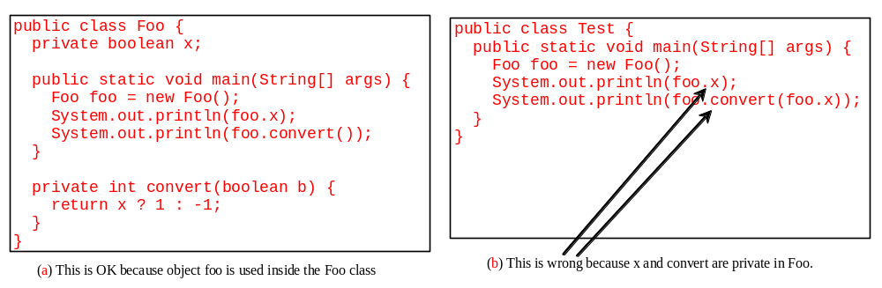
NOTE
An object cannot access its private members, as shown in (b). It is OK, however, if the object is declared in its own class, as shown in (a).

Slide 47
Why Data Fields Should Be private?
To protect data.
To make class easy to maintain.

Slide 48

Example of
Data Field Encapsulation
Circle3
TestCircle3
Run

Slide 49
Immutable Objects and Classes
If the contents of an object cannot be changed once the object is created, the object is called an immutable object and its class is called an immutable class. If you delete the set method in the Circle class in the preceding example, the class would be immutable because radius is private and cannot be changed without a set method.
A class with all private data fields and without mutators is not necessarily immutable. For example, the following class Student has all private data fields and no mutators, but it is mutable.

Slide 50
Example
public class BirthDate {
private int year;
private int month;
private int day;
public BirthDate(int newYear,
int newMonth, int newDay) {
year = newYear;
month = newMonth;
day = newDay;
}
public void setYear(int newYear) {
year = newYear;
}
}
public class Student {
private int id;
private BirthDate birthDate;
public Student(int ssn,
int year, int month, int day) {
id = ssn;
birthDate = new BirthDate(year, month, day);
}
public int getId() {
return id;
}
public BirthDate getBirthDate() {
return birthDate;
}
}
public class Test {
public static void main(String[] args) {
Student student = new Student(111223333, 1970, 5, 3);
BirthDate date = student.getBirthDate();
date.setYear(2010); // Now the student birth year is changed!
}
}

Slide 51
What Class is Immutable?
For a class to be immutable, it must mark all data fields private and provide no mutator methods and no accessor methods that would return a reference to a mutable data field object.

Slide 52
Passing Objects to Methods
Passing by value for primitive type value (the value is passed to the parameter)
Passing by value for reference type value (the value is the reference to the object)
TestPassObject
Run

Slide 53
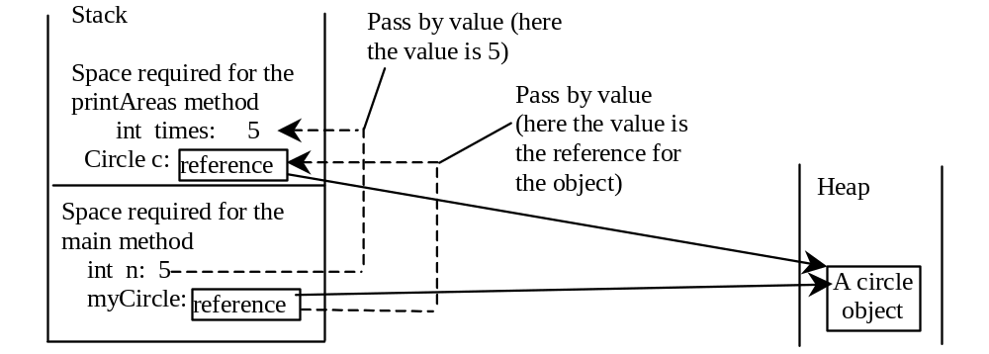
Passing Objects to Methods, cont.

Slide 54
Scope of Variables
The scope of instance and static variables is the entire class. They can be declared anywhere inside a class.
The scope of a local variable starts from its declaration and continues to the end of the block that contains the variable. A local variable must be initialized explicitly before it can be used.

Slide 55
The this Keyword
Use this to refer to the object that invokes the instance method.
Use this to refer to an instance data field.
Use this to invoke an overloaded constructor of the same class.

Slide 56
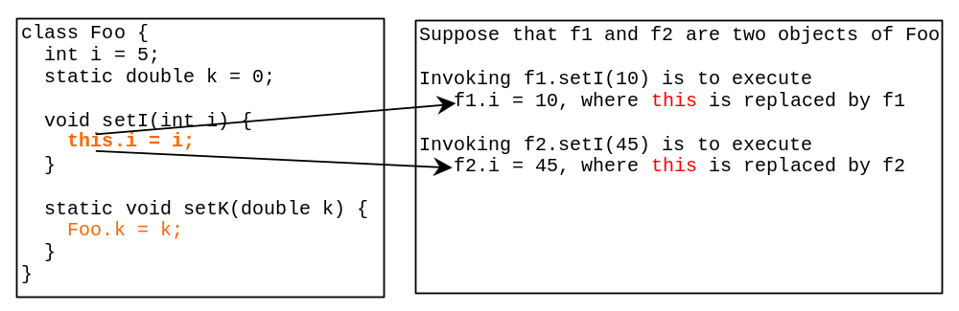
Serving as Proxy to the Calling Object

Slide 57

Calling Overloaded Constructor

Slide 58
Array of Objects
Circle[] circleArray = new Circle[10];
An array of objects is actually an array of reference variables. So invoking circleArray[1].getArea() involves two levels of referencing as shown in the next figure. circleArray references to the entire array. circleArray[1] references to a Circle object.

Slide 59
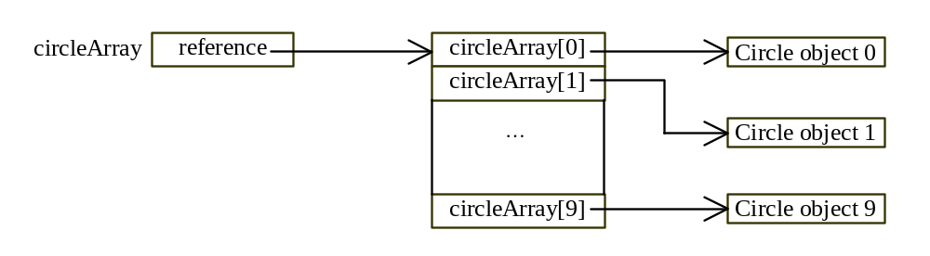
Array of Objects, cont.
Circle[] circleArray = new Circle[10];

Slide 60
Array of Objects, cont.
Summarizing the areas of the circles
TotalArea
Run

Slide 61

Class Abstraction and Encapsulation
Class abstraction means to separate class implementation from the use of the class. The creator of the class provides a description of the class and let the user know how the class can be used. The user of the class does not need to know how the class is implemented. The detail of implementation is encapsulated and hidden from the user.

Slide 62
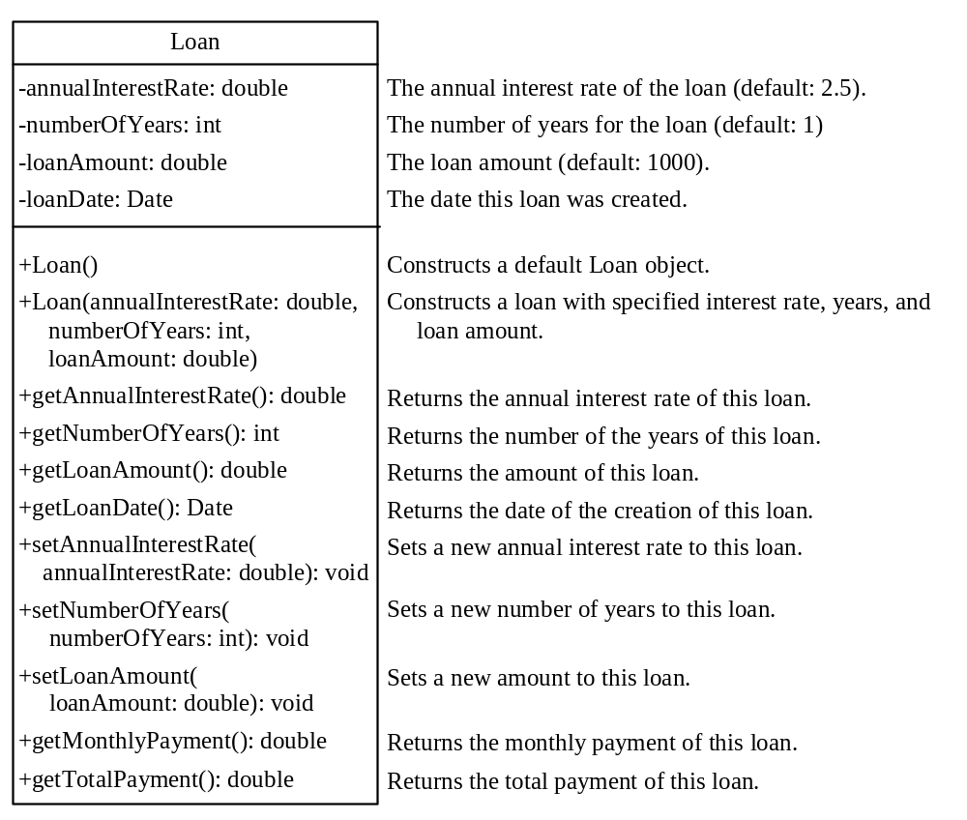
Example: The Loan Class
Loan
TestLoanClass
Run

Slide 63
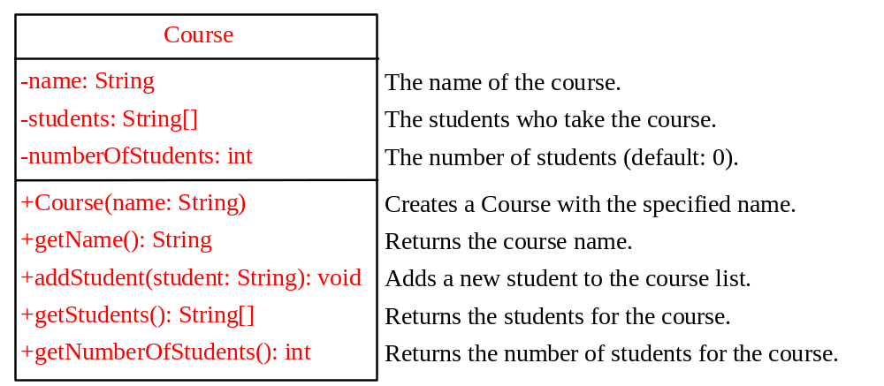
Example: The Course Class
Course
TestCource
Run

Slide 64

Example: The StackOfIntegers Class
TestStackOfIntegers
Run

Slide 65
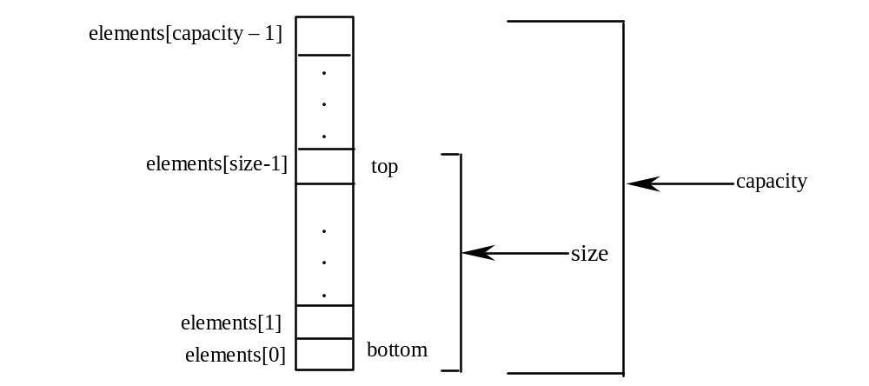
Implementing StackOfIntegers Class
StackOfIntegers

Slide 66
Note to Instructor
You can now cover Chapter 8, “Strings and Text I/O,” or Chapter 12, “GUI Basics.”

Slide 67
Creating Windows Using the JFrame Class
Optional
GUI
Objective: Demonstrate using classes from the Java library. Use the JFrame class in the javax.swing package to create two frames; use the methods in the JFrame class to set the title, size and location of the frames and to display the frames.
TestFrame
Run

Slide 68
Trace Code
animation
Declare, create, and assign in one statement
JFrame frame1 = new JFrame(); frame1.setTitle("Window 1"); frame1.setSize(200, 150); frame1.setVisible(true); JFrame frame2 = new JFrame(); frame2.setTitle("Window 2"); frame2.setSize(200, 150); frame2.setVisible(true);
frame1
reference
  : JFrame
title:
width:
height:
visible:

Slide 69
Trace Code
animation
JFrame frame1 = new JFrame(); frame1.setTitle("Window 1"); frame1.setSize(200, 150); frame1.setVisible(true); JFrame frame2 = new JFrame(); frame2.setTitle("Window 2"); frame2.setSize(200, 150); frame2.setVisible(true);
frame1
reference
Set title property
  : JFrame
title: "Window 1"
width:
height:
visible:

Slide 70
Trace Code
animation
JFrame frame1 = new JFrame(); frame1.setTitle("Window 1"); frame1.setSize(200, 150); frame1.setVisible(true);
JFrame frame2 = new JFrame(); frame2.setTitle("Window 2"); frame2.setSize(200, 150); frame2.setVisible(true);
frame1
reference
  : JFrame
title: "Window 1"
width: 200
height: 150
visible:
Set size property

Slide 71
Trace Code
animation
JFrame frame1 = new JFrame(); frame1.setTitle("Window 1"); frame1.setSize(200, 150); frame1.setVisible(true);
JFrame frame2 = new JFrame(); frame2.setTitle("Window 2"); frame2.setSize(200, 150); frame2.setVisible(true);
frame1
reference
  : JFrame
title: "Window 1"
width: 200
height: 150
visible: true
Set visible property

Slide 72
Trace Code
animation
JFrame frame1 = new JFrame(); frame1.setTitle("Window 1"); frame1.setSize(200, 150); frame1.setVisible(true);
JFrame frame2 = new JFrame(); frame2.setTitle("Window 2"); frame2.setSize(200, 150); frame2.setVisible(true);
frame1
reference
  : JFrame
title: "Window 1"
width: 200
height: 150
visible: true
Declare, create, and assign in one statement
frame2
reference
  : JFrame
title:
width:
height:
visible:

Slide 73
Trace Code
animation
JFrame frame1 = new JFrame(); frame1.setTitle("Window 1"); frame1.setSize(200, 150); frame1.setVisible(true);
JFrame frame2 = new JFrame(); frame2.setTitle("Window 2"); frame2.setSize(200, 150); frame2.setVisible(true);
frame1
reference
  : JFrame
title: "Window 1"
width: 200
height: 150
visible: true
frame2
reference
Set title property
  : JFrame
title: "Window 2"
width:
height:
visible:

Slide 74
Trace Code
animation
JFrame frame1 = new JFrame(); frame1.setTitle("Window 1"); frame1.setSize(200, 150); frame1.setVisible(true);
JFrame frame2 = new JFrame(); frame2.setTitle("Window 2"); frame2.setSize(200, 150); frame2.setVisible(true);
frame1
reference
  : JFrame
title: "Window 1"
width: 200
height: 150
visible: true
frame2
reference
  : JFrame
title: "Window 2"
width: 200
height: 150
visible:
Set size property

Slide 75
Trace Code
animation
JFrame frame1 = new JFrame(); frame1.setTitle("Window 1"); frame1.setSize(200, 150); frame1.setVisible(true);
JFrame frame2 = new JFrame(); frame2.setTitle("Window 2"); frame2.setSize(200, 150); frame2.setVisible(true);
frame1
reference
  : JFrame
title: "Window 1"
width: 200
height: 150
visible: true
frame2
reference
  : JFrame
title: "Window 2"
width: 200
height: 150
visible: true
Set visible property

